Slide 1
Microsoft 365 platform community call
aka.ms/m365pnp
Your host in this call: Fabian Williams & Brian T. Jackett
September 20, 2022

Slide 2
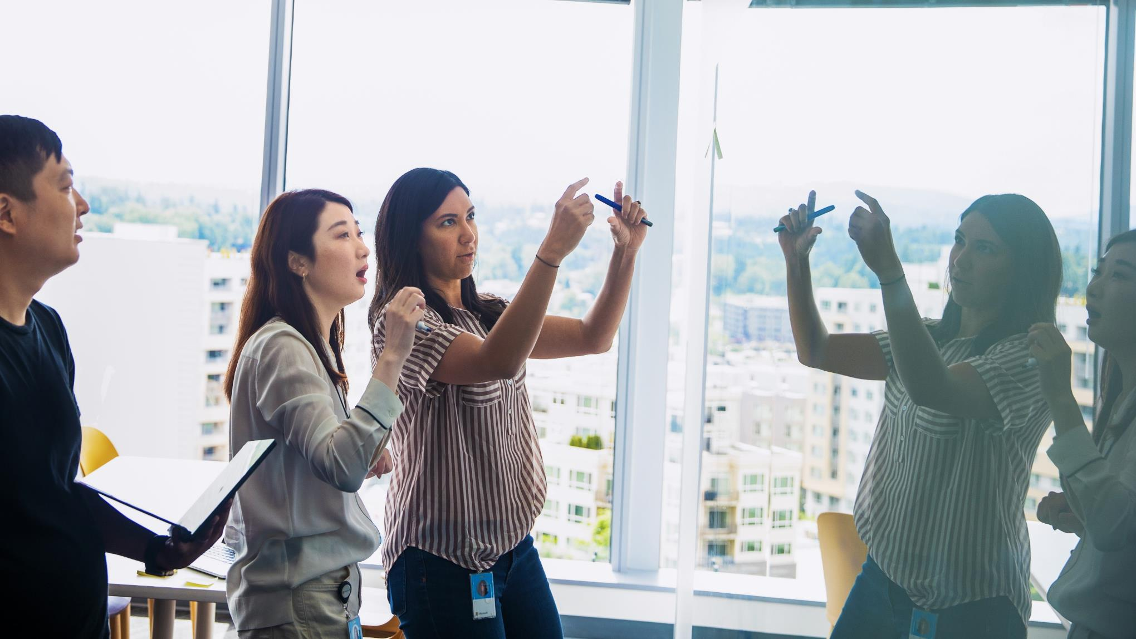



Agenda
Latest updates and news on the Microsoft 365 platform
Group picture time with Together Mode!
Demos
Adriana Wood, Liam Fernandez - Introduction to SharePoint Online Admin APIs on Microsoft Graph
Garry Trinder - Getting started with Teams Toolkit for Visual Studio

Slide 3
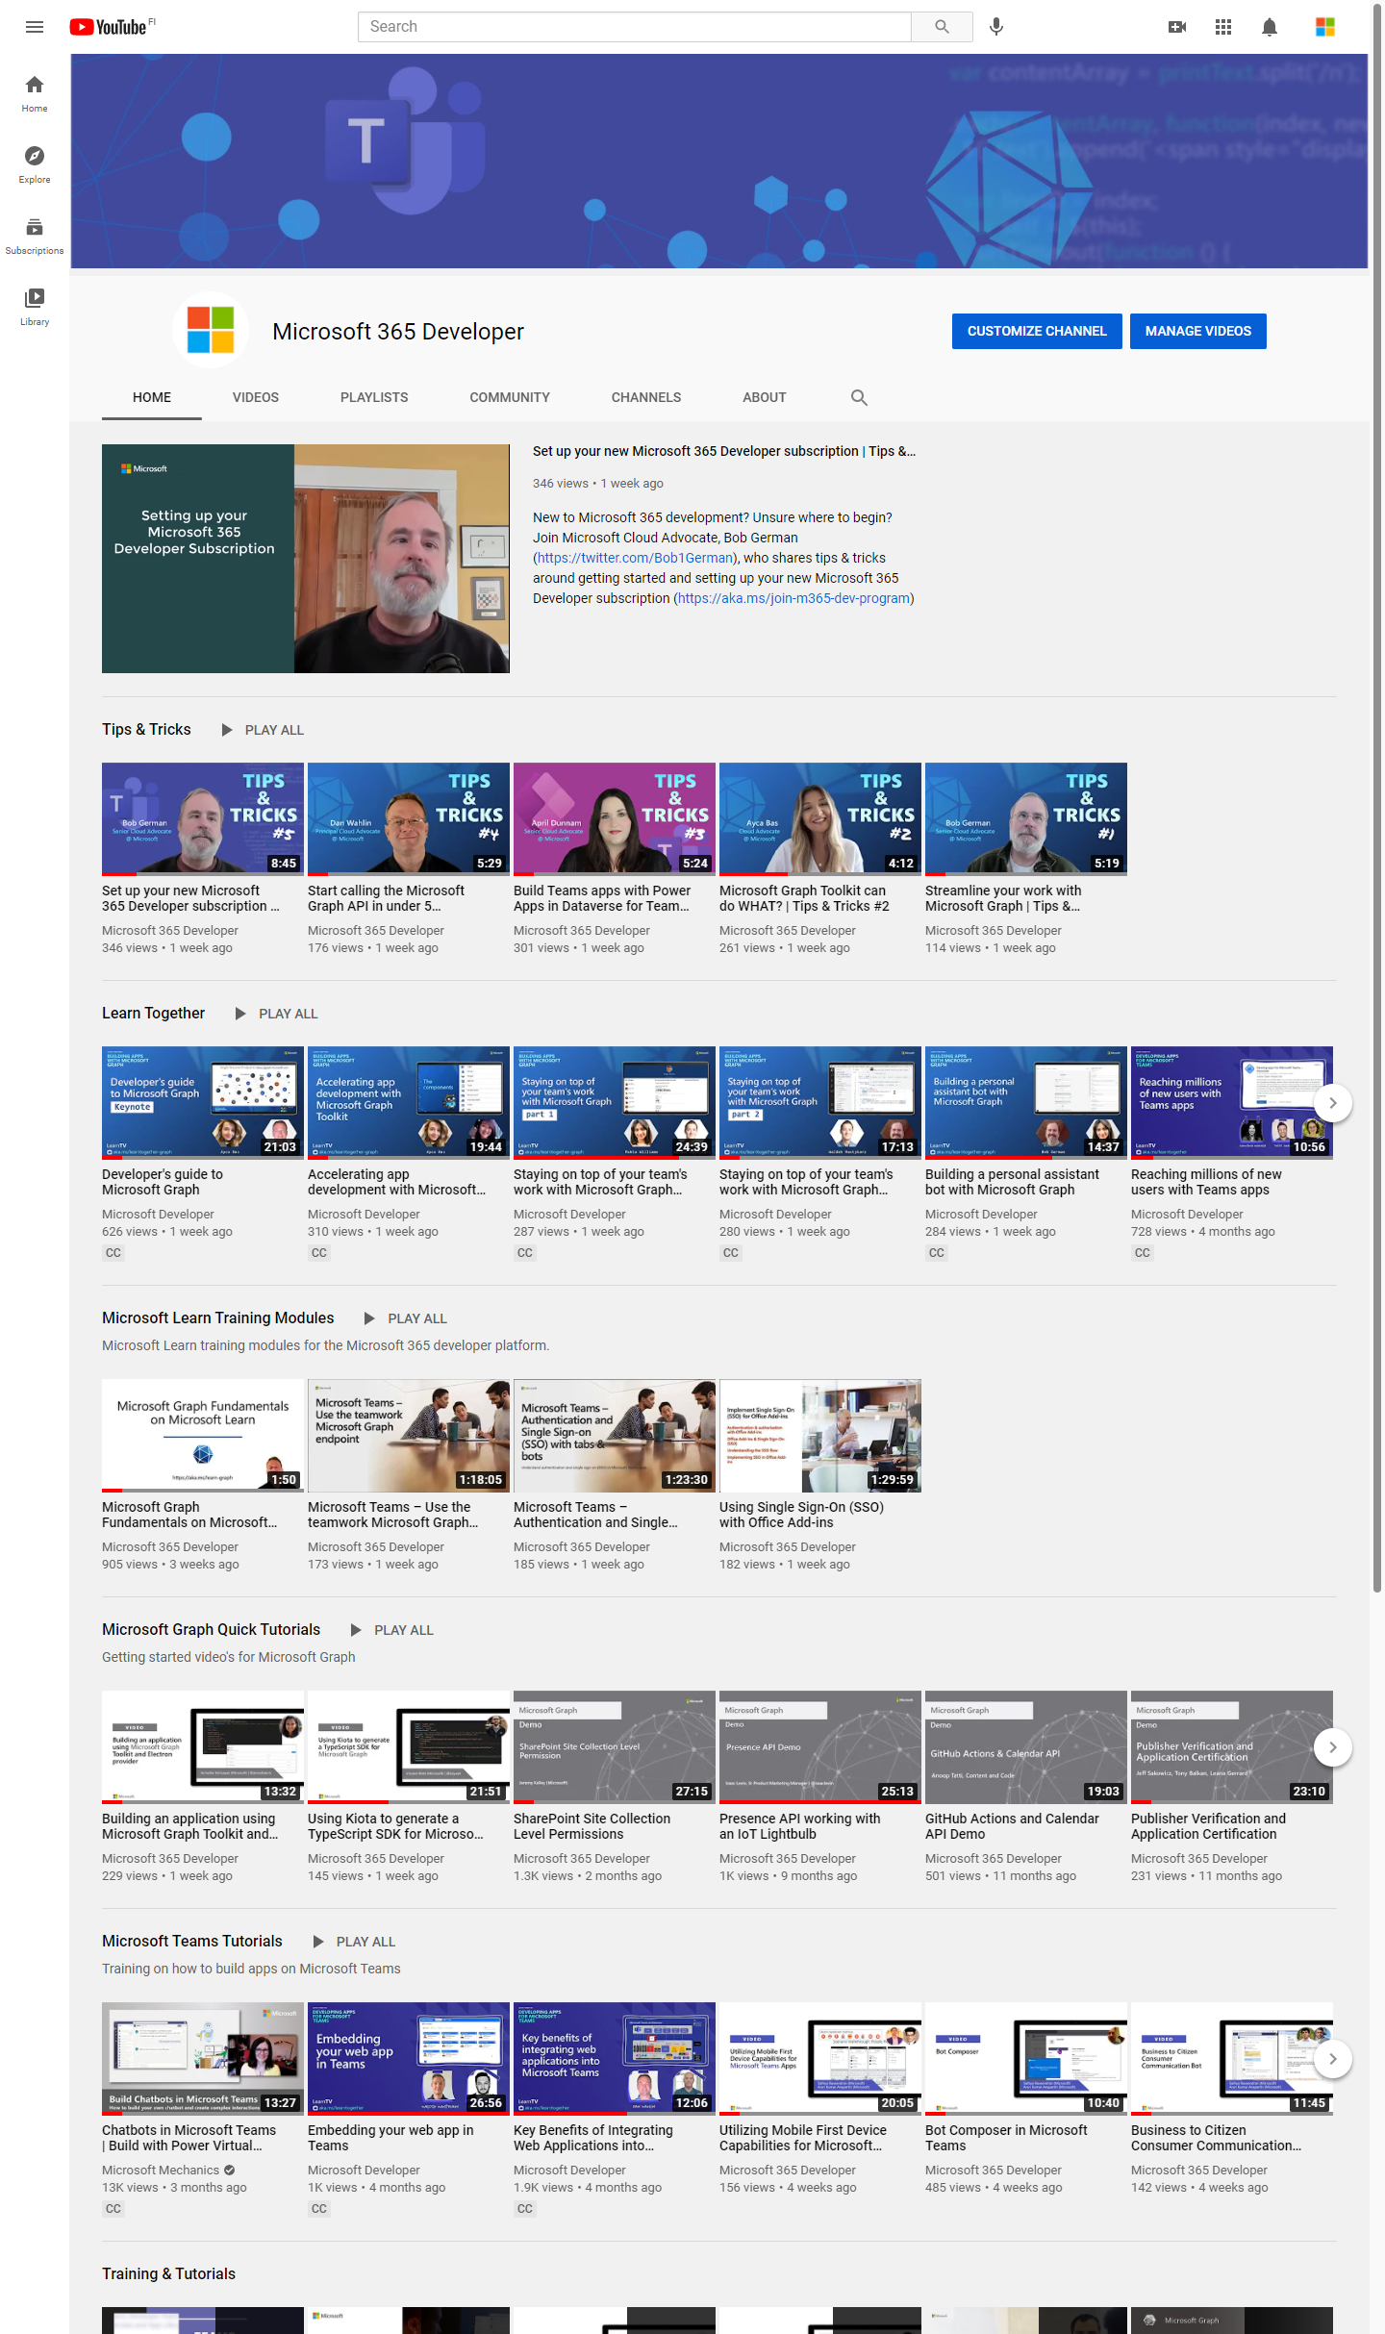
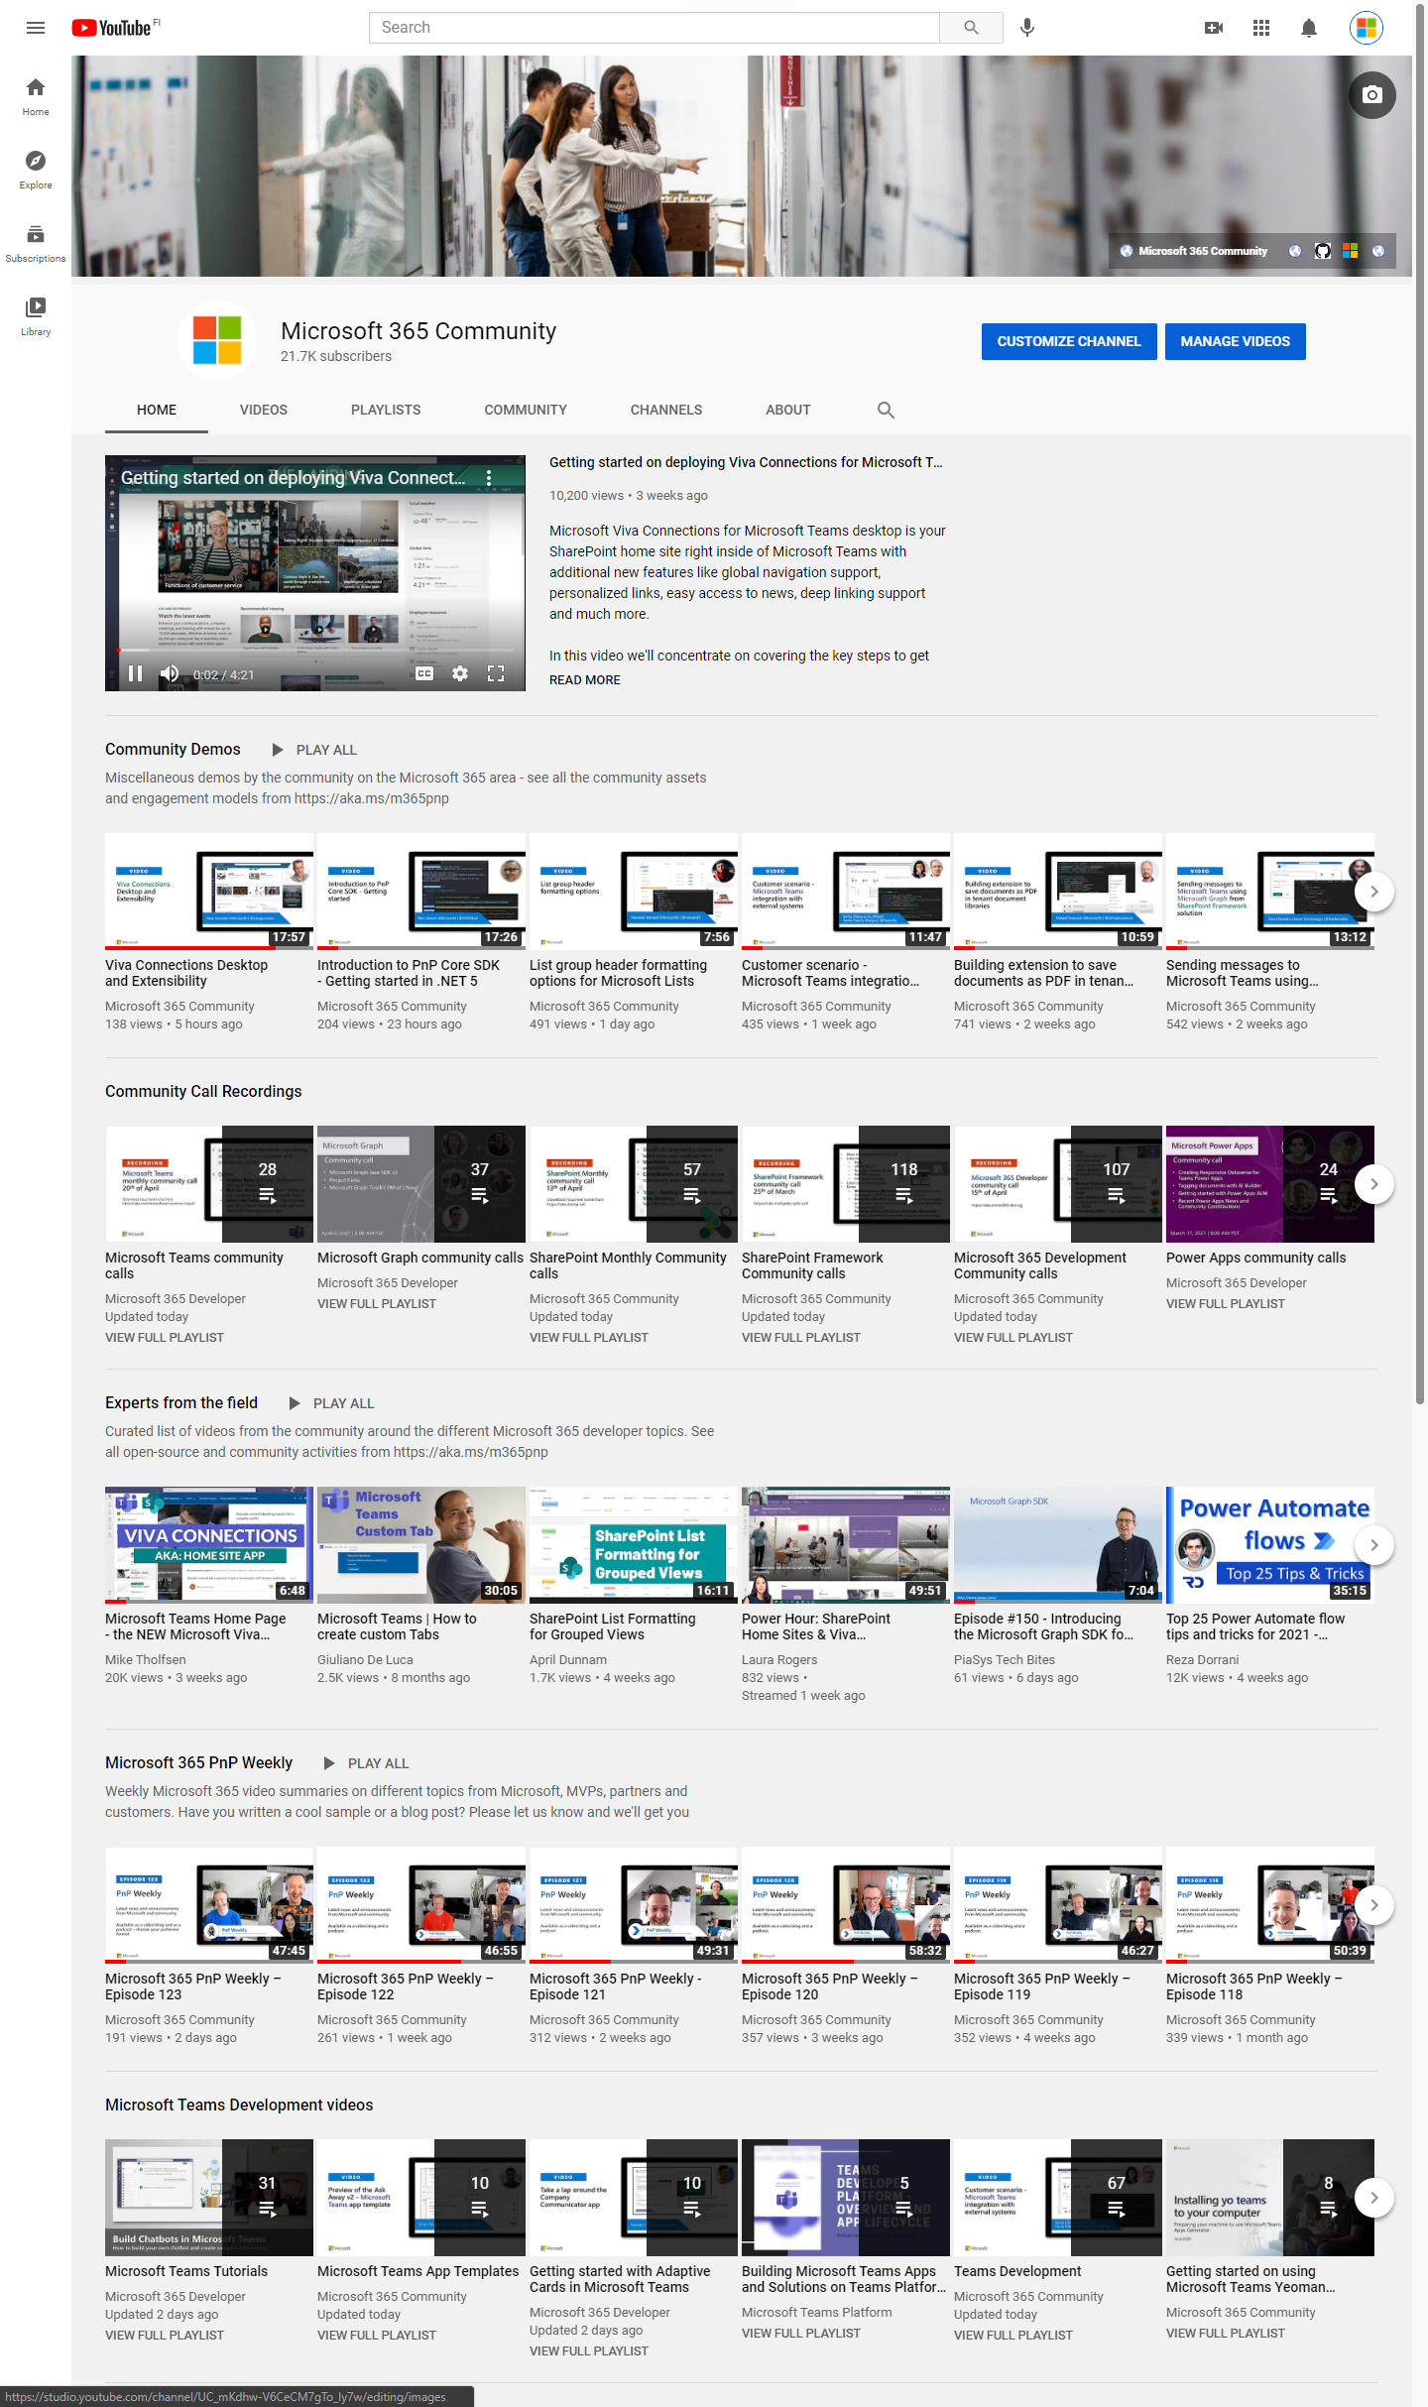
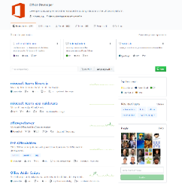
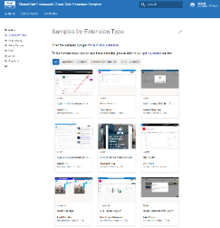
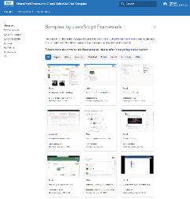
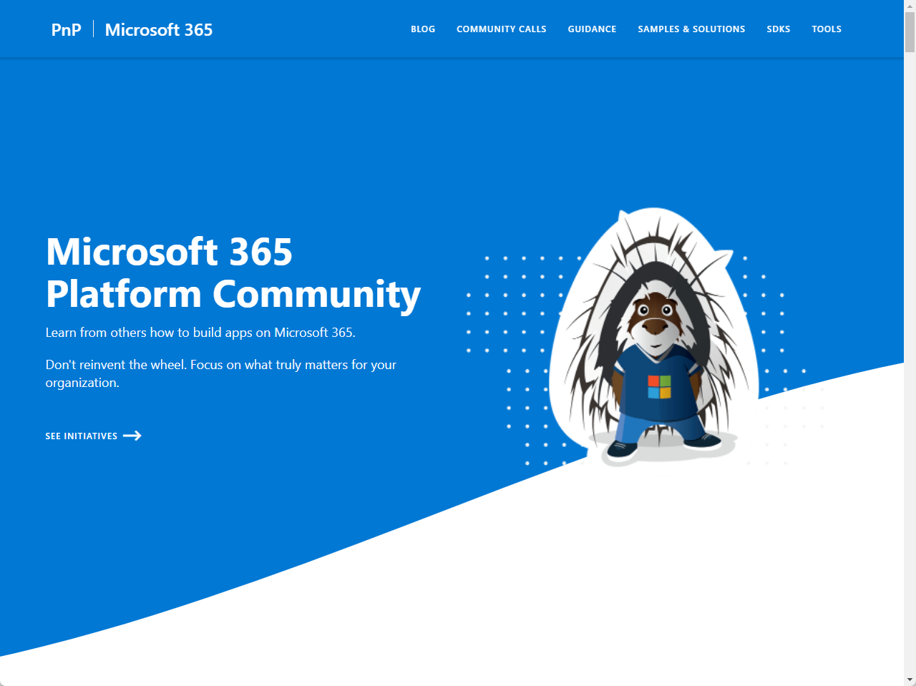
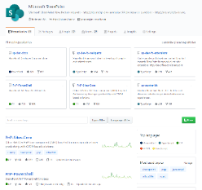
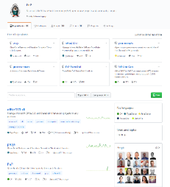
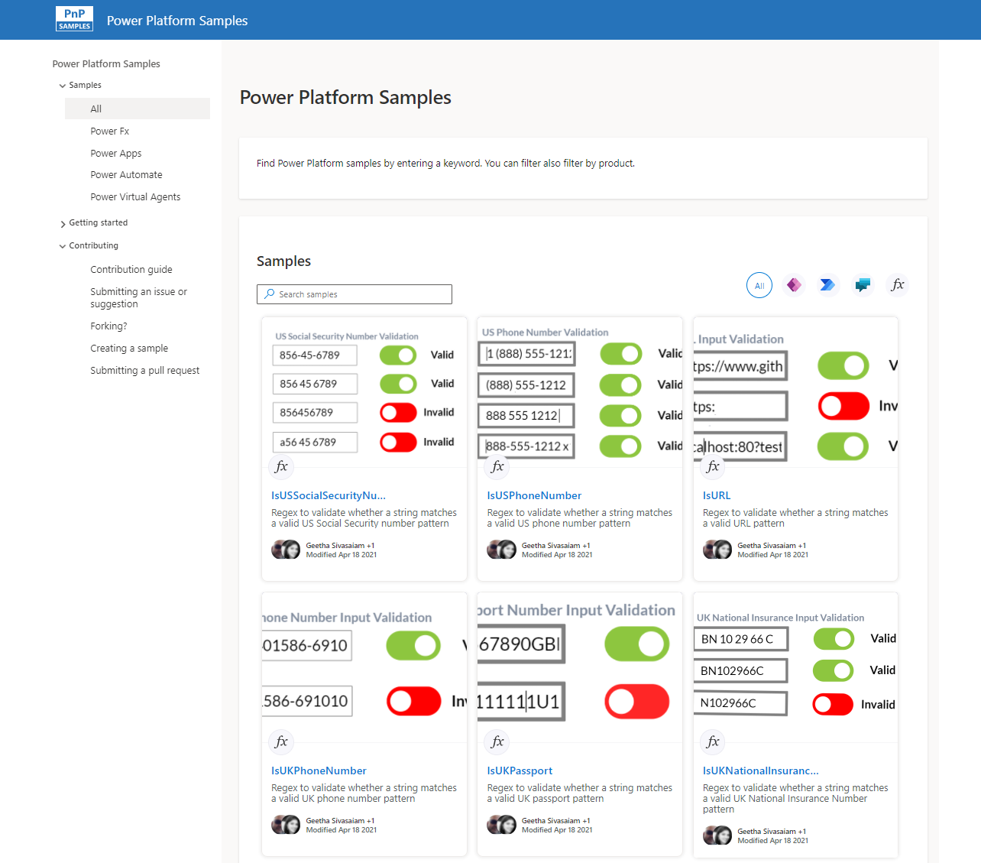
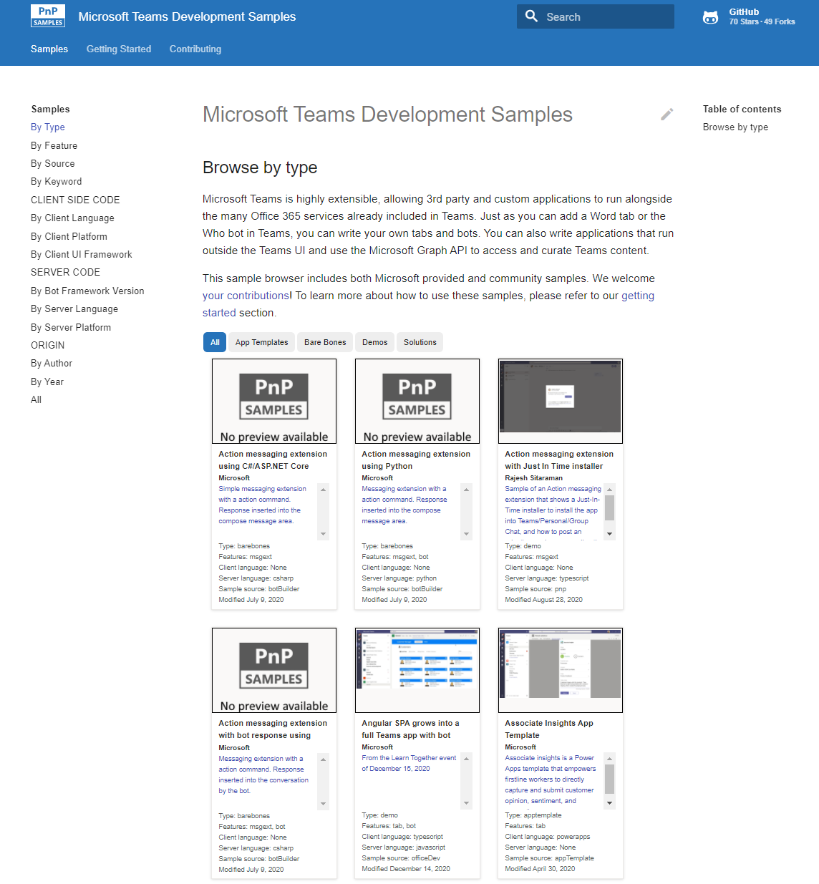
Microsoft 365 developer videos
Microsoft 365 community videos
Open-source
Sample galleries
Open-source initiatives and samples
aka.ms/m365devyoutube
aka.ms/m365/videos
github.com/pnp
github.com/officedev
github.com/sharepoint
github.com/microsoftgraph
aka.ms/m365/samples
aka.ms/teams-samples
aka.ms/spfx-webparts
aka.ms/powerplatform-samples
aka.ms/spfx-extensions
aka.ms/list-formatting
aka.ms/m365/community
@Microsoft365Dev | @m365pnp

Slide 4
Microsoft 365 developer community calls
Microsoft 365 platform (weekly) https://aka.ms/m365-dev-call
Adaptive Cards https://aka.ms/adaptivecardscommunitycall
Microsoft identity platform https://aka.ms/IDDevCommunityCalendar
Office Add-ins https://aka.ms/officeaddinscommunitycall
Power Platform https://aka.ms/PowerAppsMonthlyCall
Microsoft 365 and Power Platform community (bi-weekly) https://aka.ms/m365-dev-sig
Viva Connections & SharePoint Framework (bi-weekly) https://aka.ms/spfx-call
Download recurrent invites from
https://aka.ms/m365/calls
Notes:
m365-dev-sig

Slide 5
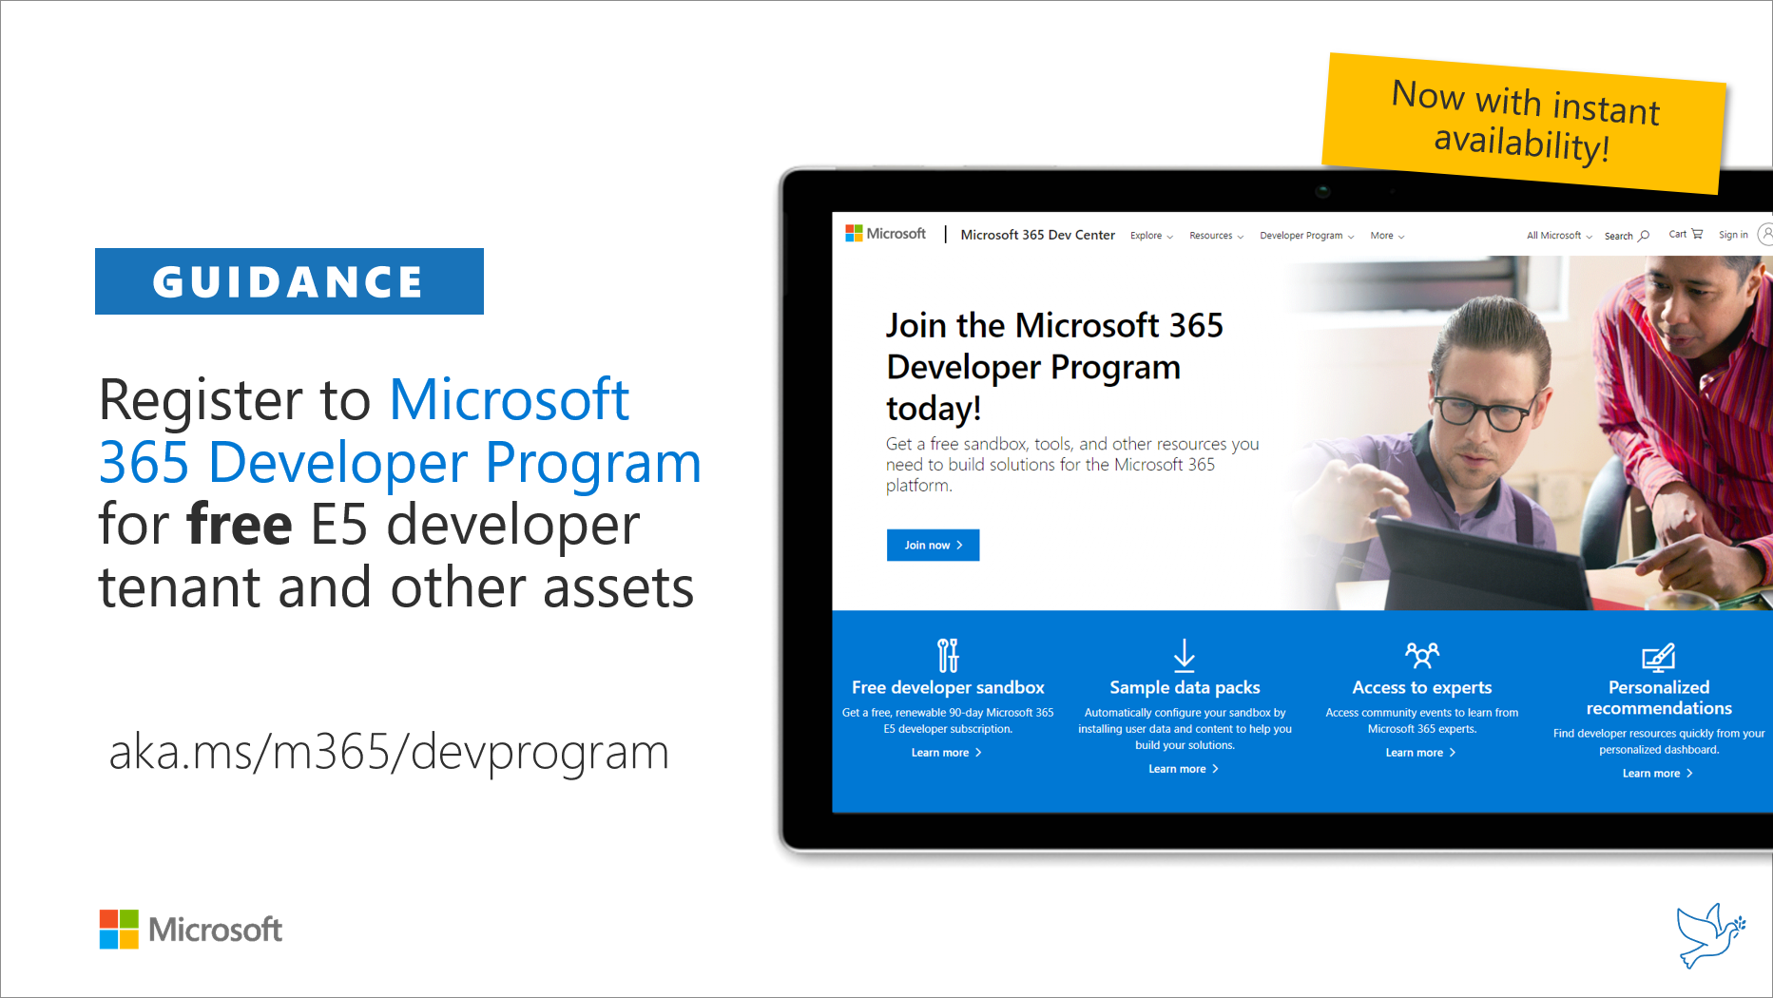
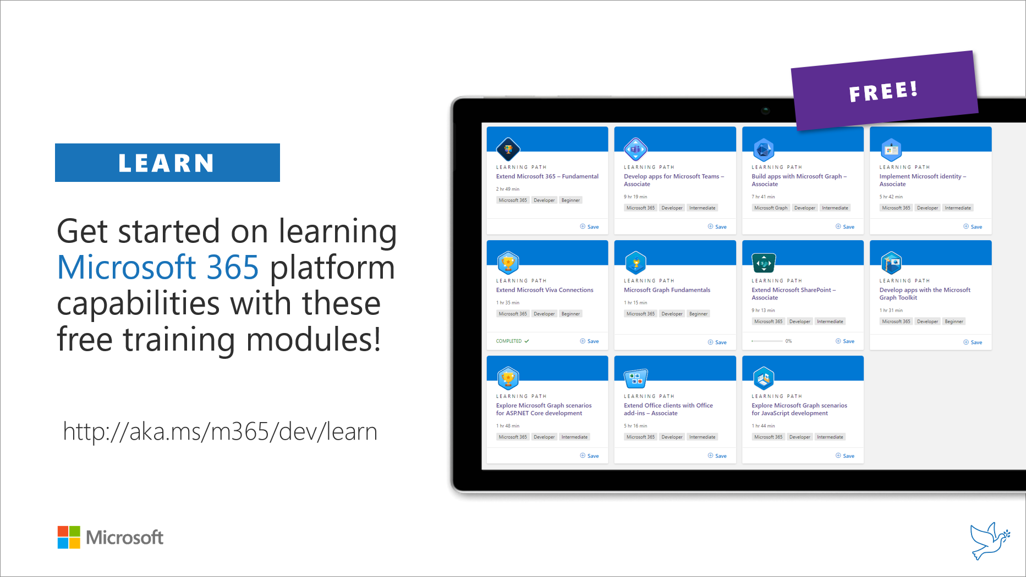
Getting started assets for Microsoft 365 dev
aka.ms/m365/devprogram
aka.ms/m365/dev/learn

Slide 6

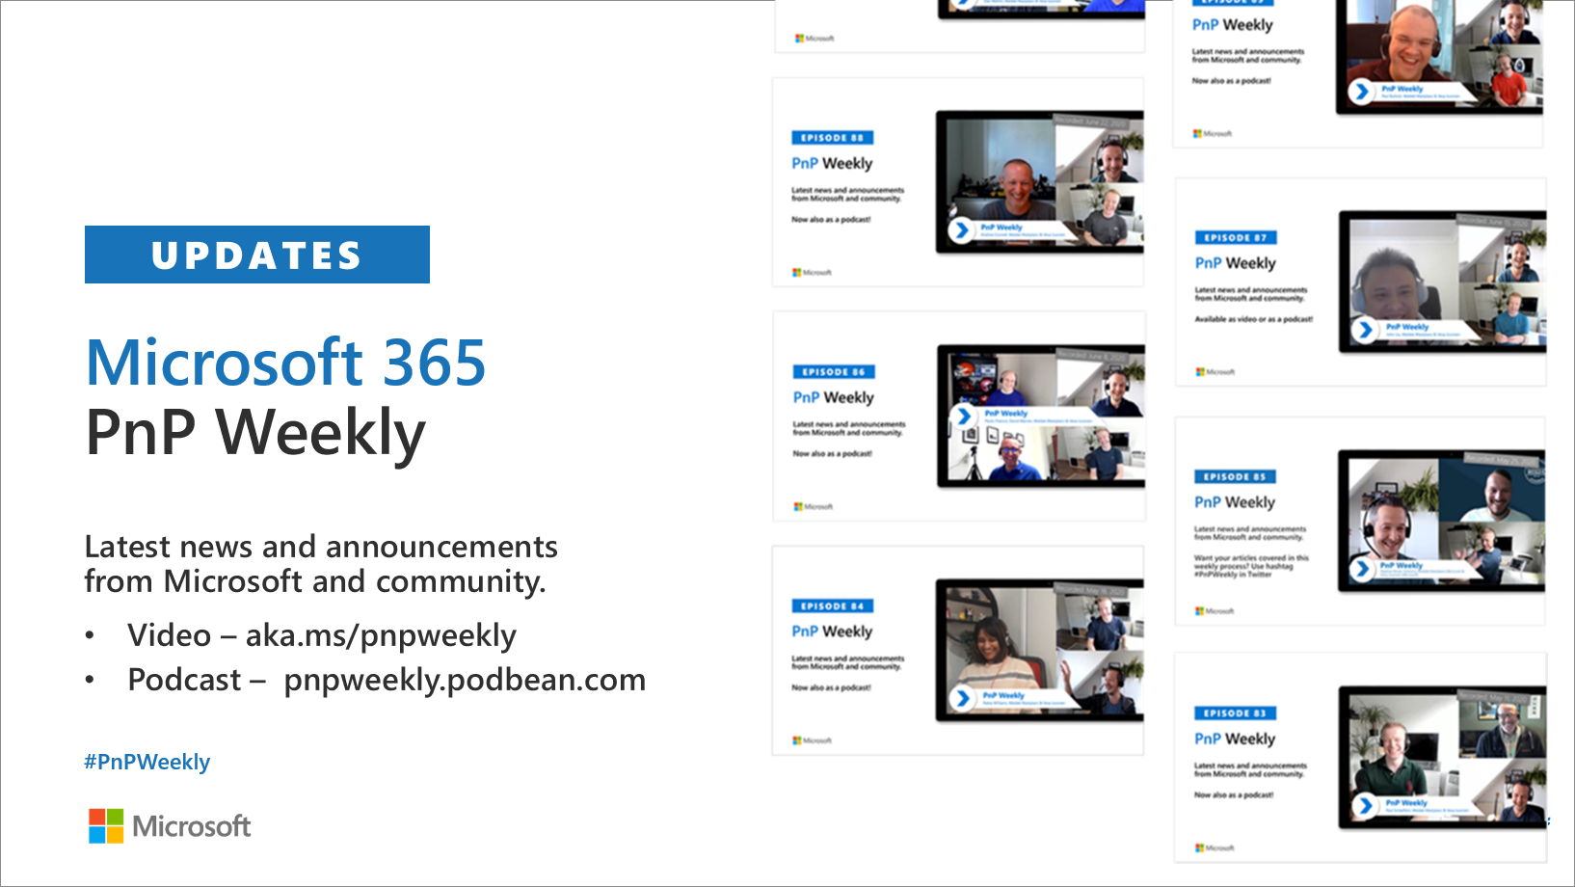
Microsoft 365 Developer podcasts
m365devpodcast.com
Video – aka.ms/pnpweekly
Podcast – pnpweekly.podbean.com

Slide 7
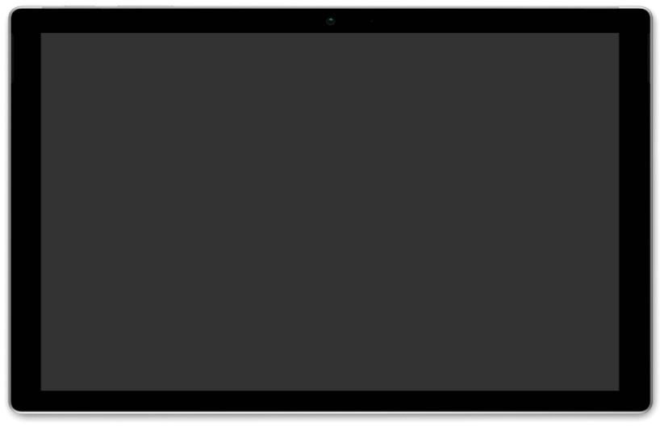
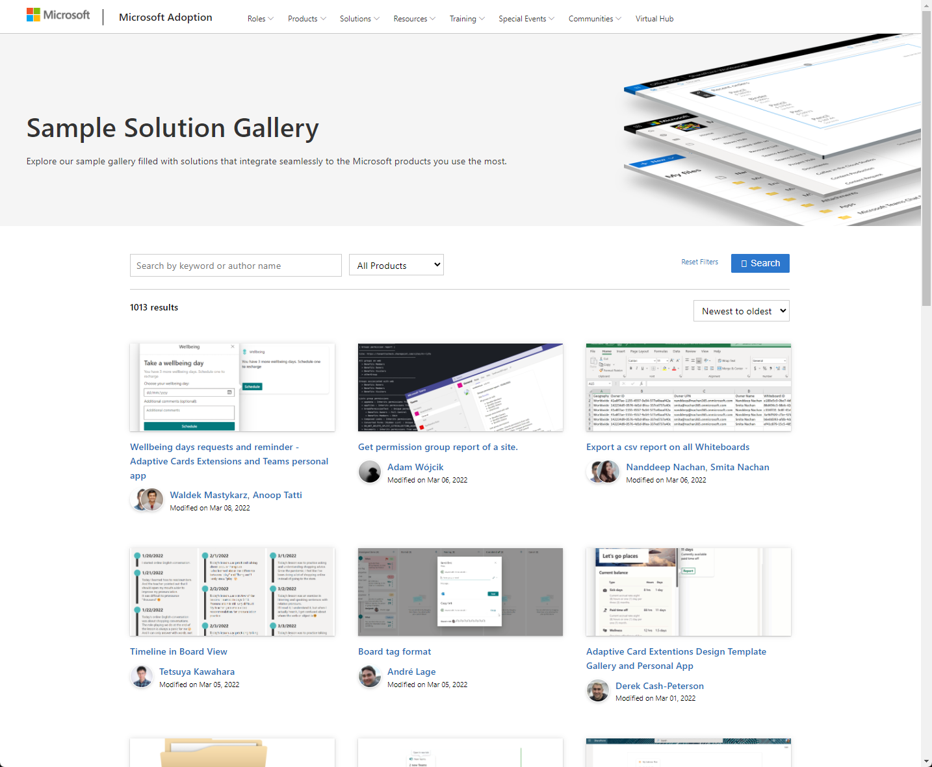
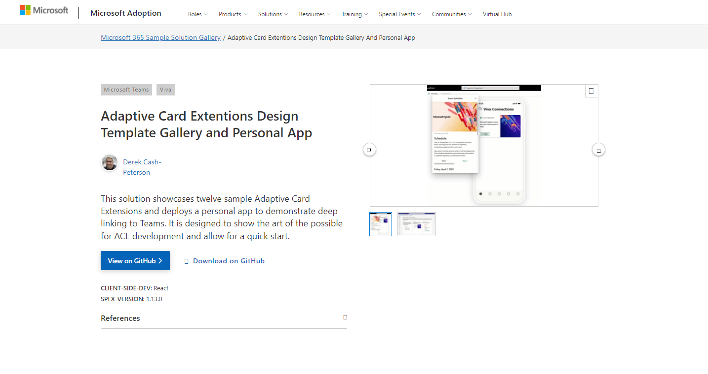
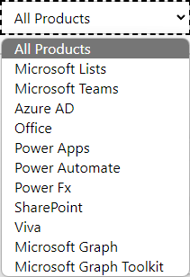

SAMPLES
New Microsoft 365 sample gallery with more than 500 samples from Microsoft and community
1100
aka.ms/m365/samples

Slide 8
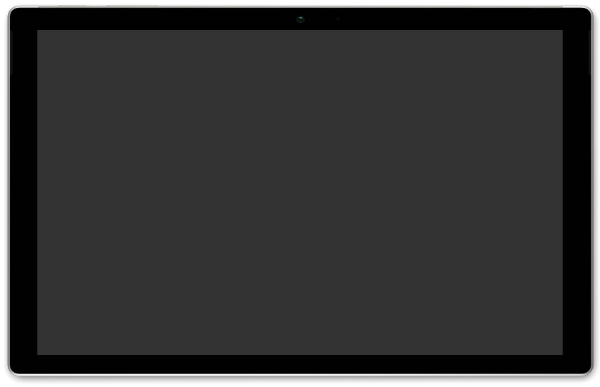
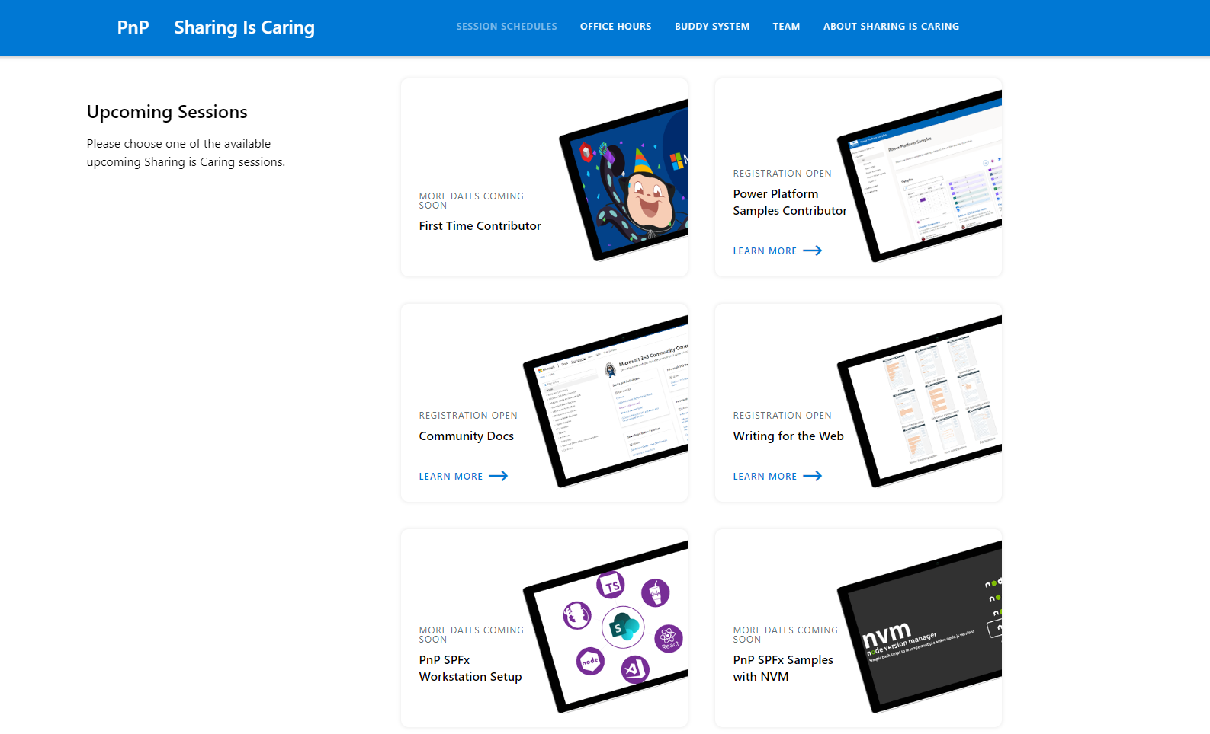
GUIDANCE
Learn how to get started in the open-source PnP community!
Upcoming Sessions:
General First Time Contributor
Power Platform Samples Contributor
Writing for the Web
SPFx Developer Workstation Setup
Using PnP SPFx samples w/ NVM
More than code with VS Code
First-time presenter
M365 Maturity Model Practitioners
Power Platform Samples Contributor
Power Platform
Conference Session Wednesday
Underway
https://aka.ms/sharing-is-caring
Notes:
25 Total attendees, 16 attendees who attended both First-Time Contributors and Community Docs sessions.

Slide 9

https://aka.ms/app-camp

Slide 10

EVENT
Registration now open:
https://ignite.microsoft.com

Slide 11

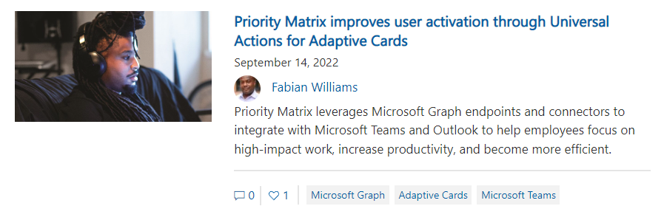
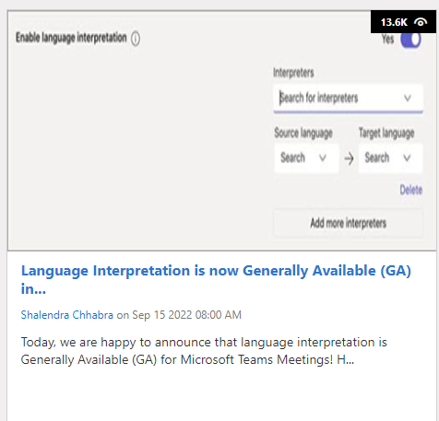
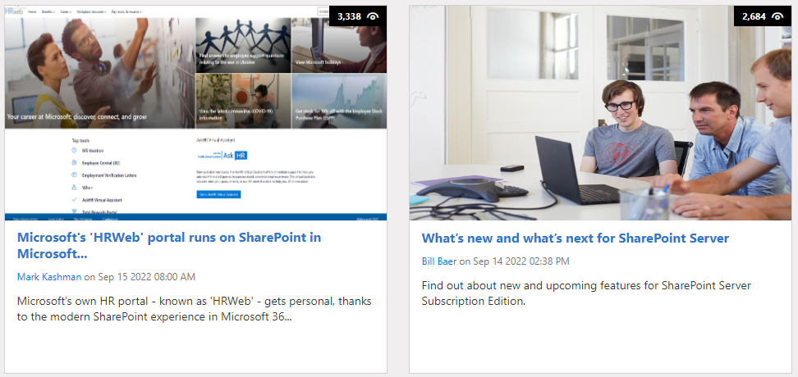
https://aka.ms/m365dev/blog
https://aka.ms/teams/blog
https://aka.ms/microsoftviva/blog
https://aka.ms/sp-blog
Notes:
Priority Matrix improves user activation by 20% -- https://devblogs.microsoft.com/microsoft365dev/priority-matrix-improves-user-activation-through-universal-actions-for-adaptive-cards/
Language Interpretation is now GA -- https://techcommunity.microsoft.com/t5/microsoft-teams-blog/language-interpretation-is-now-generally-available-ga-in/ba-p/3628382
Microsoft HRWeb Portal runs SP in MSFT -- https://techcommunity.microsoft.com/t5/microsoft-sharepoint-blog/microsoft-s-hrweb-portal-runs-on-sharepoint-in-microsoft-365/ba-p/3627806
Whats new and whats next for SP Server -- https://techcommunity.microsoft.com/t5/microsoft-sharepoint-blog/what-s-new-and-what-s-next-for-sharepoint-server/ba-p/3627729

Slide 12


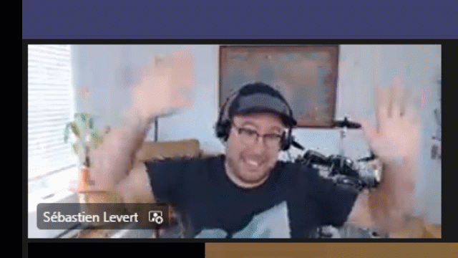
Optional picture time!
Video on and we’ll grab a Together Mode pic with those who are willing to do this.
We are together on this as a community!
Let’s all be like Seb
By enabling your camera for the picture, you grant us permission to share your picture in social media.

Slide 13

DEMO
Introduction to SharePoint Online Admin APIs on Microsoft Graph - Adriana Wood - Liam Fernandez
Getting started with Teams Toolkit for Visual Studio - Garry Trinder

Slide 14
Thank you
Recording will be available in 24 hours on
Microsoft 365 Community (PnP) YouTube channel
https://aka.ms/m365/videos
(subscribe today)
Follow us on Twitter
@Microsoft365Dev | @M365PnP
Next Microsoft 365 Platform call: September 27th at 08:00 am PT
All available community calls from https://aka.ms/m365/calls

Slide 15



aka.ms/m365pnp

